Slide 1
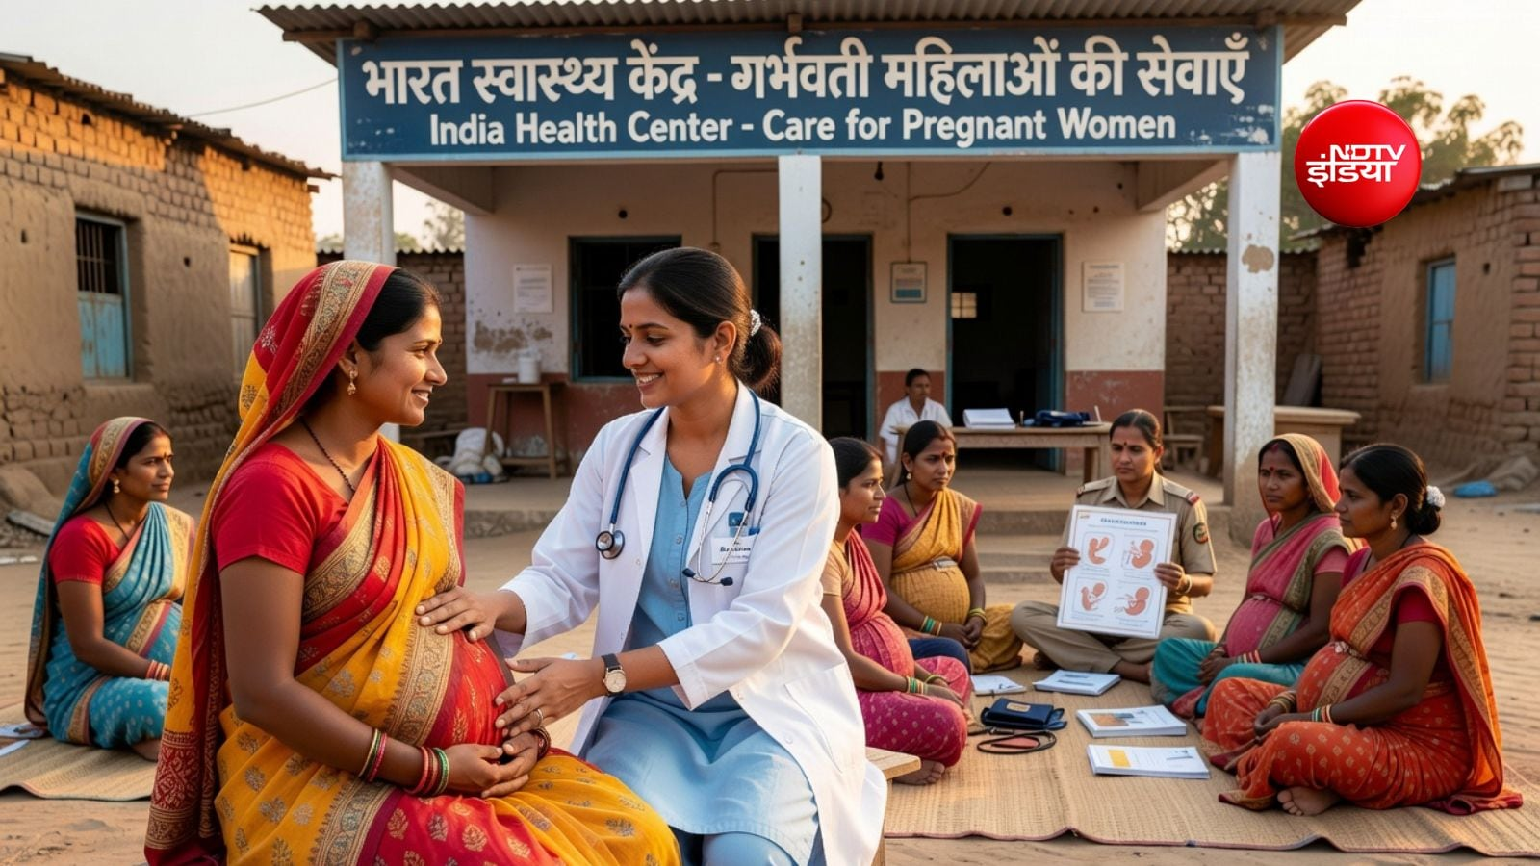

FIELD PROJECT PRESENTATION
WOMEN’S
HEALTH CARE
A survey-based study of healthcare access and everyday health practices
Prepared by: Sushmakumari Yadav & Krinjal Machhi
Coures: SY Bsc.IT
Roll no: 108 & 34
01

Slide 2
Problem Statement & Why We Chose This Topic
Women’s health is influenced by access to care, awareness, time, and daily habits.
WHY WE CHOSE THIS TOPIC
PROBLEM STATEMENT
• Women’s health deserves regular attention, not only care during illness.
• Preventive check-ups can help identify concerns earlier.
• Healthy sleep and physical activity support overall well-being.
• Understanding barriers helps suggest practical, community-level improvements.
Many women may delay preventive check-ups or face barriers to timely healthcare. Cost, distance, limited time, and lack of awareness can affect when and how people seek care.
02

Slide 3
Objectives of the Project
The study focuses on awareness, habits, and access to healthcare.
01
02
Share clear information about menstrual health, nutrition, mental well-being and personal hygine.
Encaurage healthy habits through
reminder and hydration activities.
03
04
Help user find docter information and
learn about health camps.
Make prescription instruction easier to understand.
03

Slide 4
Survey Questions
Responses shown in the provided survey charts.
SURVEY SNAPSHOT
QUESTIONS INCLUDED IN THE SHARED RESULTS
• How often do you have a health check-up?
• How often do you exercise or engage in physical activity?
• Do you get enough sleep?
• What is the biggest problem you face in accessing healthcare?
78–79
responses across the four displayed questions
04

Slide 5
Survey Results
Percentages are reproduced from the supplied charts.
How often do you have a health check-up? (n=79)
Do you get enough sleep? (n=78)
Key point: half of respondents reported going for a check-up only when sick; 33.3% said they always or usually get enough sleep.
05

Slide 6
Survey Results
Multiple responses may be possible for the healthcare-access question.
How often do you exercise? (n=78)
Biggest problem accessing healthcare (n=78)
Biggest problem accessing healthcare (n=78)
Top barrier: treatment cost (34.6%). 35.9% reported exercising rarely or never.
06

Slide 7
Outcome, Findings & Recommendations
What the survey suggests—and what can be done next.
KEY FINDINGS
PROPOSED SOLUTIONS
• 50.6% go for a check-up only when sick; only 5.1% reported check-ups every six months.
• 35.9% exercise 1–2 days a week and another 35.9% rarely/never exercise.
• 34.6% selected treatment cost as a major access problem.
• 25.6% reported a lack of nearby facilities; 20.5% cited lack of time.
• Sleep responses are mixed: 39.7% usually and 26.9% always get enough sleep.
• Organise affordable women’s health check-up camps and referral support.
• Share clear information on preventive care and when to seek medical advice.
• Promote small, regular activity goals and consistent sleep routines.
• Improve awareness of nearby clinics, public facilities, and available health schemes.
• Offer flexible timings and confidential, respectful care.
07

Slide 8
CONCLUSION
Small steps can make
women’s healthcare stronger.
The survey highlights opportunities to encourage preventive check-ups, regular physical activity, healthy sleep, and better access to affordable care. Community awareness and practical support can help people make informed health decisions.
Thank you
08

